Slide 1
Hazard Communication and Safety Awareness for Contractors Entering Penn Laboratories
Environmental Health & Radiation Safety
215-898-4453
Notes:
Version for outside contractors who enter Penn labs.

Slide 2
Hazard Communication at PENN
This training is for contractors who may enter laboratories, but do not perform laboratory work.
This training fulfills Penn’s Hazard Communication training requirements for multi-employer workplaces.
This training covers only Penn specific hazards. Your employer must also provide you with training to comply with OSHA 1910.1200 Hazard Communication standard.

Slide 3
Hazard Communication
After taking this training, you should be able to recognize and understand hazards in the laboratory, understand how to protect yourself from hazards, know where to find additional hazard information, and understand how to handle emergencies that may arise.

Slide 4
Work Coordination
Never
enter a laboratory unless you have spoken with the building administrator and the lab group.
The Penn Project Manager can assist you in contacting these individuals.
Ensure that work times are approved by the project manager or building administrator. These individuals will coordinate with the lab group.

Slide 5
Laboratory Safety Awareness
You will not be working with laboratory chemicals, but it is important to understand the types of hazards that are present in laboratories on campus and how to protect yourself from specific hazards
We will discuss:
Safety Data Sheets (SDS)
Laboratory signage and labeling
Personal Protective Equipment (PPE)

Slide 6
Identifying Chemical Hazards

Slide 7
Laboratory Hazards
Laboratories may contain a variety of hazards, such as
Acids
Bases
Flammable solvents
Toxic chemicals
Biological agents
These materials should be removed by the lab from the immediate work area.

Slide 8
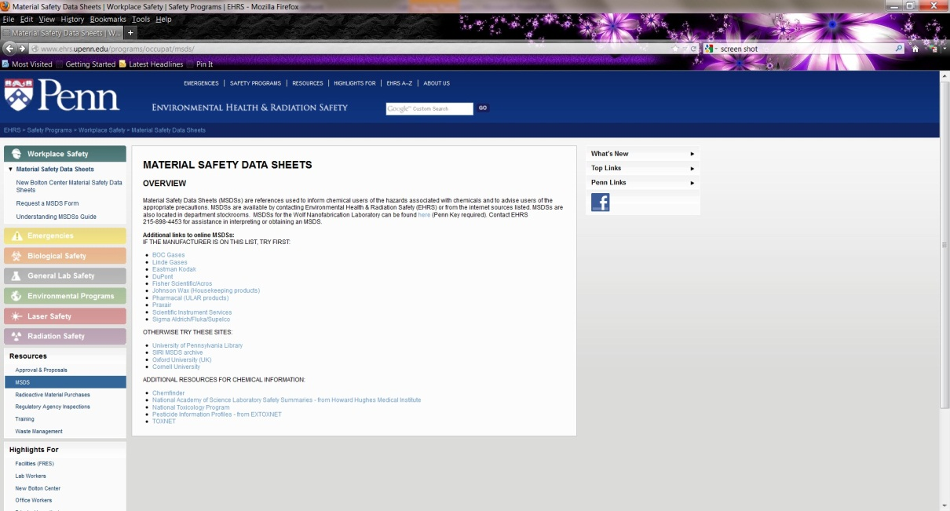
Safety Data Sheets (“SDS”)
Safety data sheets are available for all chemicals used on campus. Contractors or vendors can obtain SDS’s from the Office of Environmental Health and Radiation Safety (EHRS) http://www.ehrs.upenn.edu/programs/occupat/msds/
3160 Chestnut Street, suite 400
215-898-4453
Many SDS are also online
i.e. Fisher Scientific and Sigma Aldrich
Chemical SDS are available on their websites
Many are available through search engines such
as Google
SDS’s are provided by manufacturers

Slide 9
What information is in a Manufacturer Safety Data Sheet (SDS)?
 | Section | Description
1 | Identification | Name, Manufacturer, Uses
2 | Hazard Identification | Label information
3 | Composition | Ingredients, concentrations
4 | First Aid | Recommendations
5 | Fire-Fighting | Extinguishing, special information
6 | Accidental Release | Containment, cleanup
7 | Handling and Storage | Precautions
8 | Exposure Control/PPE | PELs, TLVs, Engineering Controls, PPE

Slide 10
SDS (cont’d)
 | Section | Description
9 | Physical and Chemical Characteristics | Appearance, odor, flammability
10 | Stability and Reactivity | Stable or unstable
11 | Toxicological Information | Routes of exposure, acute and chronic health effects, symptoms
12 | Ecological Information
13 | Disposal Considerations | Non-mandatory
14 | Transport Information
15 | Regulatory Information
16 | Other | NFPA, Revision date

Slide 11
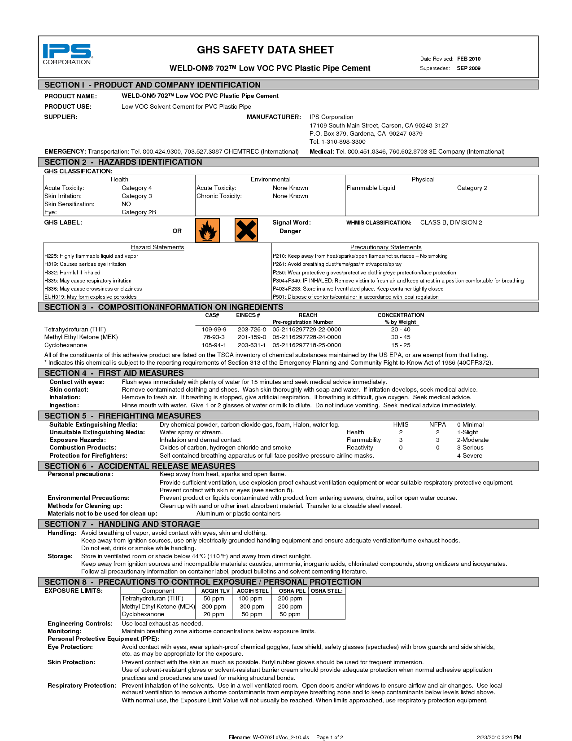

Slide 12
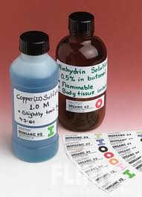
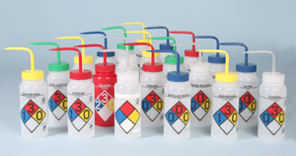
Types of chemical labeling that you may see on campus:
Manufacturer Label
Laboratory Label
Product name
“Danger” or “Warning"
Pictogram
Hazard statement
Precautionary statements
Manufacturer address and telephone number
Chemical name
Hazard (optional)

Slide 13
Labeling Pictograms
Oxidizer
Flammable
Explosive
Toxic
Corrosive
Gas under Pressure
Health Hazard
Environmental Hazard
Irritant

Slide 14
Entering Laboratories

Slide 15
Entering Penn Laboratories
Each building has a building administrator. You must contact the building administrator or project manager prior to entering a laboratory.
Do not enter any laboratory that is unoccupied if the door is closed, unless you have been granted access by a building administrator or project manager.
Do not enter a lab if you can accomplish your job by observing from the hallway.
When you enter a lab you must identify yourself to lab occupants.
Failure to follow these procedures could put you at risk or cause harm to the research.

Slide 16
Entering Animal Areas
Animal facilities are run by the University Laboratory Animal Resource staff (ULAR). The ULAR Manager for that facility must be contacted prior to entering an animal holding area.
Protective gear, including shoe covers, gowns and face masks may be required to enter animal areas.
You may not be able to enter multiple animal areas on the same day. Check with ULAR for entrance requirements.

Slide 17
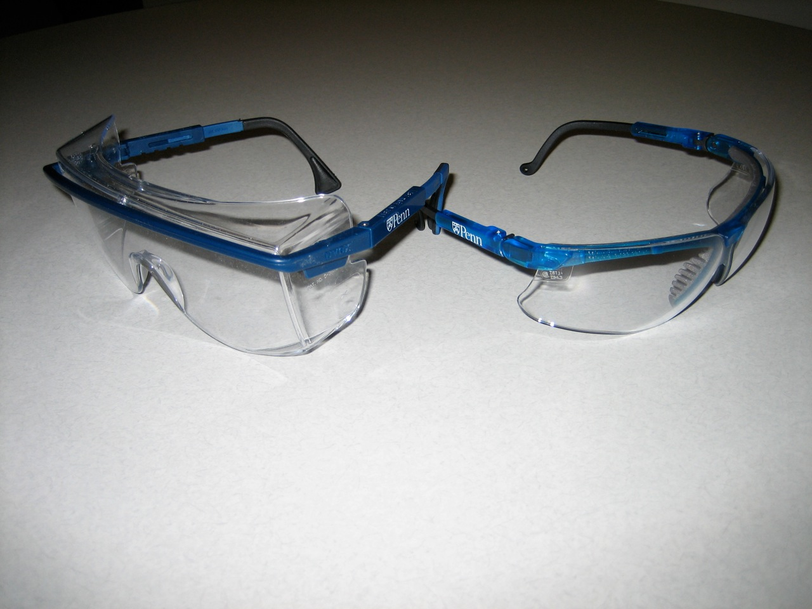
Mandatory Personal Protection
Wear safety glasses at all times when in a laboratory
Wear long pants (shorts or skirts are not appropriate) and closed toed shoes
Wear gloves if you will be touching laboratory surfaces
Avoid areas where staff are actively handling chemicals

Slide 18
University Laboratory Room Signs
Room signs are posted at the entrance to all laboratories and contain the following information:
The Primary Investigator or contact
Labels that indicate the types of hazardous materials used in the lab
Emergency contact information

Slide 19
Room Sign Label Explanations
Radioactive Material Label
This label indicates that radioactive materials are or may be used in this lab
No external hazard exists, meaning you cannot be exposed to radiation by walking into the lab
Do not touch or move anything marked with this symbol
Ask lab personnel to move equipment or to clear an area if necessary for your work

Slide 20
Room Sign Label Explanations
Biohazard Label
This label indicates that biological materials are handled in this lab that are potentially hazardous through direct contact (not inhalation)
You cannot become exposed by walking into the lab
Do not touch or move anything marked with this symbol

Slide 21
Room Sign Label Explanations
Designated Area Label
This label indicates that chemicals which are acutely toxic, carcinogenic or reproductive hazards are used in this lab
Do not touch or move anything within an area marked with this label or designated area tape
Have lab personnel clear the area if you need to work in these spaces
Designated
Area
Within

Slide 22
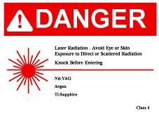
Room Sign Label Explanations
Laser Radiation Label
This label indicates that a laser is present in this lab
High powered lasers will have an additional warning sign on the door
Eye injury can occur from an accidental exposure to a high powered laser
If the laser is not in use there is no hazard
DO NOT enter a laser laboratory unless escorted by lab personnel

Slide 23
Room Sign Label Explanations
Magnetic Field and Strong Magnetic Field Labels
A magnetic field exists in the space
Persons with pacemakers or other medical implants may not enter these rooms
Metal objects are not permitted in strong magnetic field areas
DO NOT enter without a lab escort

Slide 24
Biosafety Level 3
BSL3 laboratories use biological agents that may present an airborne hazard
You will not have security access to these labs
DO NOT enter a BL3 laboratory unless escorted by laboratory personnel

Slide 25
Other Warning Signs
Other warning signs may be posted on laboratory doors when a hazardous activity is being performed
DO NOT enter unless escorted by laboratory personnel
Warning signs may change or signs may be posted during temporary experiments. Always pay attention to signs on and near laboratory doors!

Slide 26
Alarm Warning Signs
Never enter a room if an alarm is sounding
Do not enter without a lab escort

Slide 27
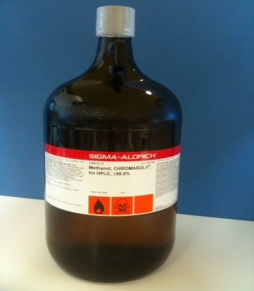
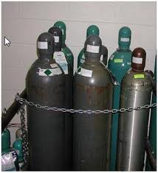
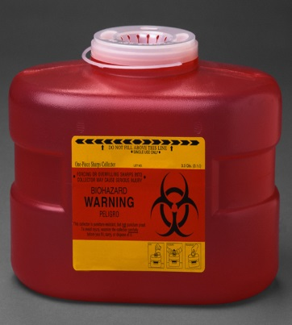
Chemicals Present in Labs
Every effort will be made to remove hazardous material from your work area. Contact your supervisor if you find any items in the work area. Chemicals that can be found include:
Flammable chemicals
Compressed gases
Corrosive chemicals
Contaminated sharps

Slide 28
Moving Laboratory Equipment
DO NOT move any lab-related items
It is the laboratory’s responsibility to move all cylinders, chemicals, hazardous waste, laboratory equipment, refrigerators, and any other lab-related items that may be in your way
If this hasn’t been done, ask someone in the lab to help you
If no one is available to help you, contact the project manager and your supervisor

Slide 29
Working Near Lab Benches
Do not step on any lab furniture or benches
Cover lab benches with plastic if your work will release dust or debris

Slide 30
Exiting Laboratories
Wash your hands after removing gloves and before you eat, drink, or smoke

Slide 31
Emergencies
It is important to know what to do in the event of an emergency when working in a laboratory or laboratory building

Slide 32
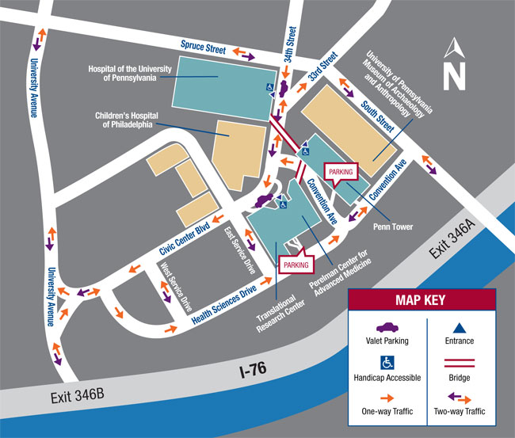
Injuries
If you are injured, follow your company’s procedures.
Medical assistance, if needed, is available at the emergency room at the Hospital of the University of Pennsylvania (HUP), 3400 Spruce Street and 34th
Penn recommends that all injuries receive treatment
Emergency assistance is available by dialing 215-573-3333 (Penn Police) or dial 511 from a University phone
Emergency Room

Slide 33
Injuries
If you are injured by a laboratory material (needlestick, chemical exposure), contact the Penn project manager.

Slide 34
Needle Sticks
Needles, razor blades and other sharp objects may be used in some laboratories
If you are stuck by a needle or cut by a sharp object in a laboratory:
Wash affected area with soap and water. Seek medical attention immediately!
Contact EHRS immediately- 215-898-4453

Slide 35
Laboratory Chemical Exposure
There are sinks in every lab and safety showers in the lab or hallway
If you are splashed with a chemical : wash the affected area with water immediately
Remove contaminated clothing, if necessary
Report to the HUP Emergency Room
Contact EHRS immediately- 215-898-4453

Slide 36
Chemical Splashes to Eyes
There are eyewashes in the lab or hallway
Rinse eye at eyewash immediately for 15 minutes (hold eye open)
Report to HUP Emergency Room
Contact EHRS- 215-898-4453

Slide 37
Asbestos Awareness
There are asbestos containing materials (ACM) in many Penn buildings.
EHRS periodically inspects ACM in all Penn buildings.
If asbestos containing materials are present in a mechanical room, the room will be signed with specific information.
DO NOT touch or disturb ACM.
Please contact EHRS at 215-898-4453 if you have questions or concerns.

Slide 38
Summary
Do not conduct any work in a laboratory until you have spoken with the building administrator and lab personnel
Use room signs, safety data sheets and labels to identify hazards
At a minimum, wear gloves, safety glasses, closed-toe shoes and long pants when entering a lab
Never move laboratory equipment, chemicals, gas cylinders or anything with a biohazard or radiation label on it

Slide 39
Summary
Only enter laboratory animal areas, laser use areas, strong magnetic field rooms with an escort
Do not enter labs if there is an alarm or strobe
Report all spills, chemical exposures and needle sticks immediately
Program the following numbers in your cell phone:
EHRS 215-898-4453 and Penn’s main Emergency Number 215-573-3333 for Penn Police
Seek immediate medical attention for chemical exposures and needle sticks

Slide 40
Questions or Concerns
Penn’s Office of Environmental Health & Radiation Safety (EHRS)
215-898-4453
ehrs@ehrs.upenn.edu

